Slide 1
Credit Risk Assessment Backend in GCP
Ali Ghorbani
Humberto Ribeiro de Souza

Slide 2
Credit Score Assessment in GCP
Business Problem
Implements endpoints for provide credit score in production environment
Architecture
Project objective
Implementation
Results
For U of T class 3760

Slide 3
Business Problem
Credit Default Risk as a Tool for Standardized Decision-Making
Credit risk tools are part of any financial institution to evaluate if money should be borrowed for all kinds of purposes. Some are purpose-built and more accurate for a given business case.
Credit Default Risk as an Inclusion Tool
Diverse initiatives across the globe have been designed and executed, some of them being even being awarded the Nobel Prize. In this case, the “Home Credit” financial institution has posted in Kaggle a problem that would provide credit to the unbanked population using alternative data such as telco and transactional information, to evaluate default likelihood. More can be found here.

Slide 4
Assumptions
01
Assumed that the Credit Home Company, which posted the Kaggle Challenge, has accepted the model to be promoted to production. The company has an aggressive growth business plan and could go tenfold in two years
02
Assumed that the team must select the best cloud provider for this need, considering that this is expected to be a low-profit and low-cost solution. Quality and simplicity are important, while response times are tolerable
03
The scope of this project is to provide an endpoint to Credit Home Company to query about credit default risk of new applicants.
04
Deprecated data for training models should be kept for audit purposes for 5 years. The model is expected to be updated fortnightly.

Slide 5
Cloud Technology Selection
Project and Volumes
Credit Home Corp expects to query between 600 - 1200 applications per day.
The front-end will send a CSV containing a header and a row that belongs to the applicant.
Security Risks
The system handles both financial and personal data therefore the connection must be secured. Sniffing, Man-in-the-middle and classical attacks should be avoided.
The company has sites in different states, has a team working from home and no VPN available at the moment.

Slide 6

On-Premises exclusion
Although the company has on-premise servers for their legacy Active Directory and related services, running models would be unsafe for the models are developed in Python 3.9 and Python libraries depend on operating systems library that needs to be patched.
Also, the solution would not scale according with the business plan without potential limitations to the business.
Cloud computing allows the application full-cycle to be managed without hardware and infrastructure concerns.

Slide 7


Cloud Provider Selection
The company has agreements with Google Cloud Platform and Amazon Web Services
The estimated monthly costs for the PROD environment are available in the table below
Component | Expected Usage | AWS | GCP
Bucket per Gb | 5 Gb inbound; 4 Gb moving within cloud | 0.19 USD | 0.115 USD
ML Engine per query | 2 runs, notebook, 8 hours of nodes running | 9.63 USD | 4.72 USD
Database per Gb + access | 30 Mbytes monthly AWS DynamoDB; GCP FireStore | 0.30 USD | Free
Functions | 500 ms of running code per req, 2 Gb of Ram, 1200 reqs per day | 0.62 USD | Free
Total/Month |  | 10.74 USD | 4.84 USD

Slide 8
Simplicity x Transparency
Architecture
Different approaches were considered for building the backend. The simplest would be based on all resources available in Vertex AI. The implementation time would be the smallest. An serverless model has been chosen for audit and transparency for a reasonable amount of implementation time.
12 h
24 h
60 h
80+ h
Vertex AI and API Endpoints, Firestore
Trained model available in Lambda, FireStore
Cloud VMs, Network and access Management
Acquire/setup hardware, OS, VMs, code

Slide 9
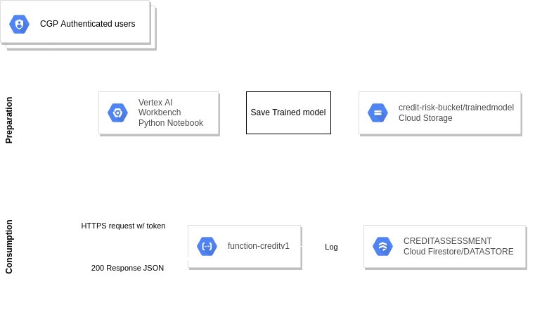
Architecture
The scope of this implementation is to expose the API endpoint for the Home Credit Company and allow assertion of the applicant credit score. The request must be recorded on a database for billing and auditing purposes. The model data is expected to be trained fortnightly and the previous data need to be stored so the model can be audited on a given point in time.

Slide 10
Project timeline - 2021/2022
NOV
DEC
JAN
FEV
MAR
APR
Analysis & SOW
Implementation Phase 1
Review Phase 1
Phase 2 Analysis & SOW
Implementation Phase 2
Review Phase 2
Discovery sessions, definition of done, selection of cloud provider, SOW
Model adjustment, environment creation, end-to-end tests, go-live
Weekly review; performance and security analysis. Preparation for phase 2
Discovery sessions, definition of done, selection of cloud provider, SOW
Aim the automation of model data updates, audit review
Review of the ensemble of phases 1 and 2 weekly

Slide 11
Architecture
Justify selection of Cloud Functions over App engine or Cloud Run
Event-driven solutions that extends to google are a good fit for cloud functions and we built function-based endpoint API therefore cloud function is the suitable choice.
Less total cost of ownership and time-to-deploy
App engine is suitable for many different services with a single application while cloud function preferred for individualized service.
Cloud Functions-like services are found on other cloud providers and it is easily portable if a change of cloud provider is requested
Cloud Run runs containers and is suitable choice to run in a stateless container. But, because of single query request of out end-pointAPI, we chose to use cloud function.

Slide 12
Architecture
Selection of Vertex AI Managed Notebooks over VM
Maintain operating system (OS) and all software upgrade using VM is not core for the company nor its analysts
Security risk of VM and continuously patching OS and ensure to keep it up to date
Do not have native access to other GCP services and native integrations capabilities using VM. This can be arranged. However, the modules are frequently updated and it incurs in maintenance overhead.
Not selected Auto ML to avoid platform dependency and maintain better visibility and easier explainability of the workflow

Slide 13
Architecture
Justify selection of FireStore/Datastore
Endpoint API needs a highly scalable document NoSQL database for small to medium size operational workloads
It is cheaper than all listed contenders*
Firestore automatically handles sharding and replication, with a highly available and durable database that scales automatically
FireStore is built for automatic scaling, high performance, and ease of application development
Firestore has key values, attributes and indices
Firestore supports Atomicity, Consistency, Isolation, and Durability (ACID) transactions, SQL-like queries, indexes.
* https://sourceforge.net/software/compare/Amazon-DynamoDB-vs-Google-Cloud-Firestore-vs-Openredis-vs-Oracle-Database/

Slide 14
Cycle diagram
Audit
Update Model Fortnightly
04
Review of results of a given applicant may be requested to run. The ensemble of information of usage and model data are necessary for the data analyst to run the audit*
A Data Analyst updates the model having the latest data at hand. Previous data is saved on bucket subfolders *
01
03
API is enabled
Usage is recorded
The front-end system consumes it
Usage is recorded for being queried by the front-end
02
* Automation of steps 1 and 4 are scope of another project

Slide 15



Introducing: Credit Risk Assessment System
The endpoint is called from an application that runs on desktop, tablet or mobile
Access to the endpoint is open by default. It requires the service account svc_credituser key to have access to it.
Approved/Reproved
The front-end system shows the status in a way the analyst can show the screen.

Slide 16
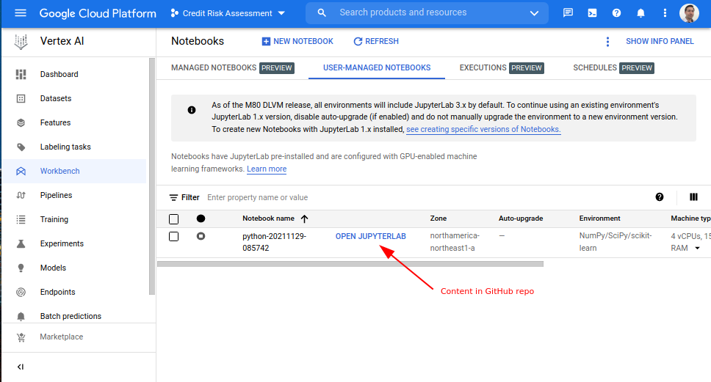
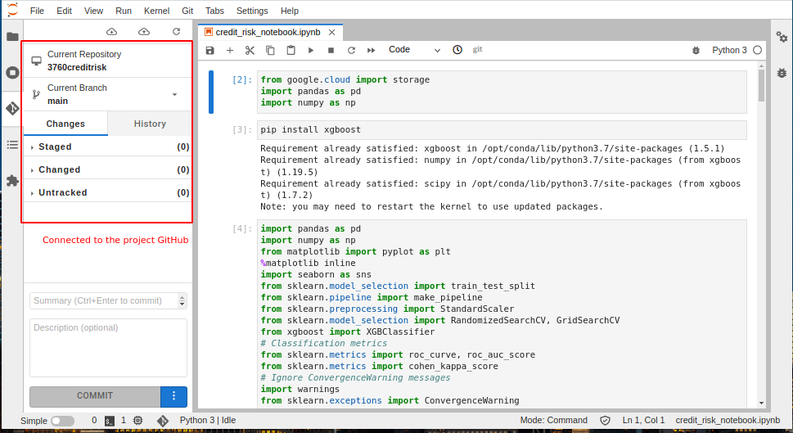
Vertex AI Notebook - Model building and exporting
> Vertex AI - Notebook was used to adapt the model to work in the cloud.
> The train and test dataset have been cleaned-up and feature-engineered.
> The model uses XGBoost classifier using randomized search for hyperparameter optimization.
> The validation method was AUC for the dataset is imbalanced.

Slide 17
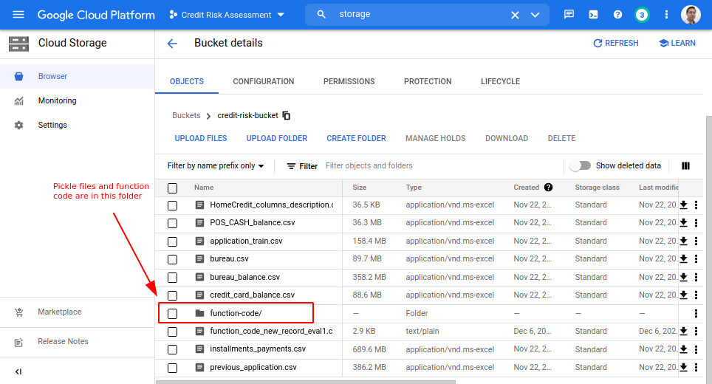
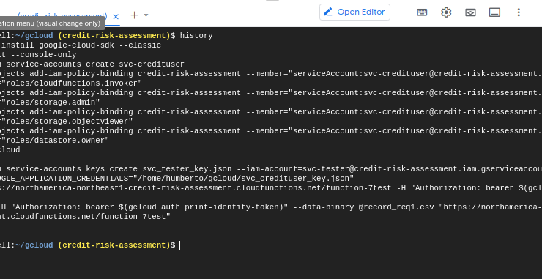
Cloud Storage and service account IAM setup
Single bucket for the project: credit-risk-bucket
Training model files for notebook are in the root
Cloud functions-related code is sorted in functions-code folder
Trained model pickle
One-Hot encoded columns pickle
Zipped cloud functions code for automated deployment

Slide 18
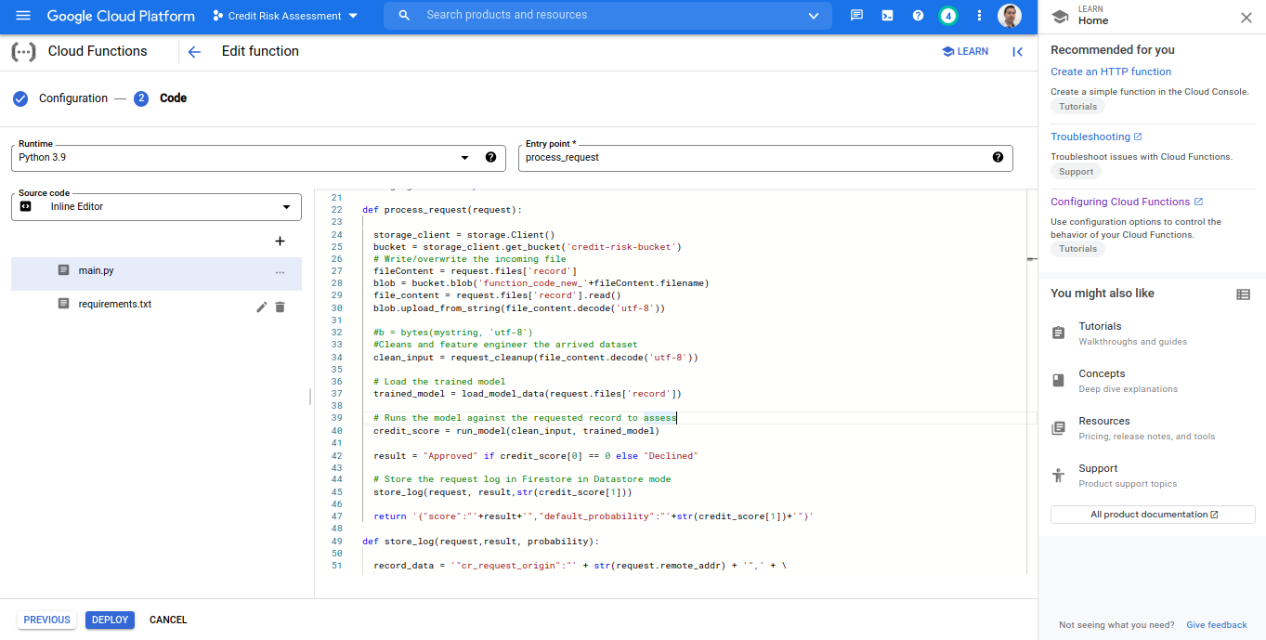
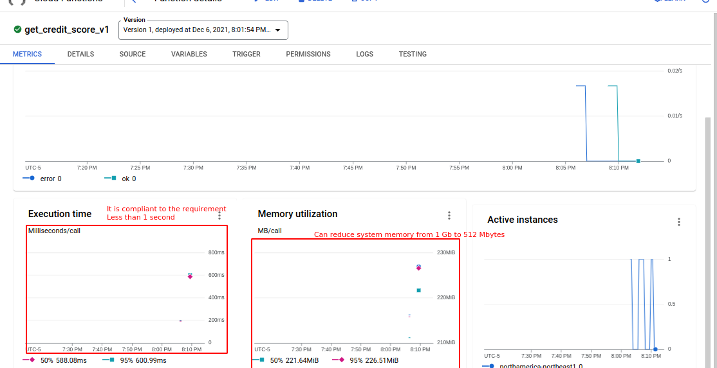
Functions Setup
The function /get_credit_score_v1 calls
The Cloud Storage for read and write operations
Loads the trained model and reference record row
Assess the record and returns the status
Saves the transaction log in FireStore running as Datastore

Slide 19
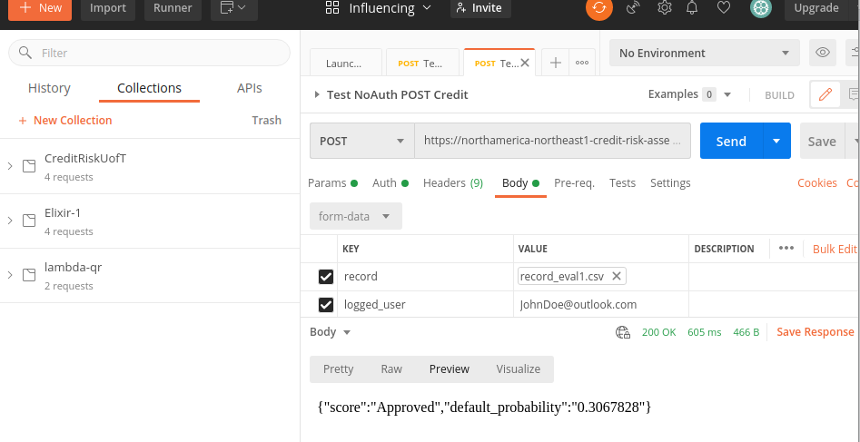
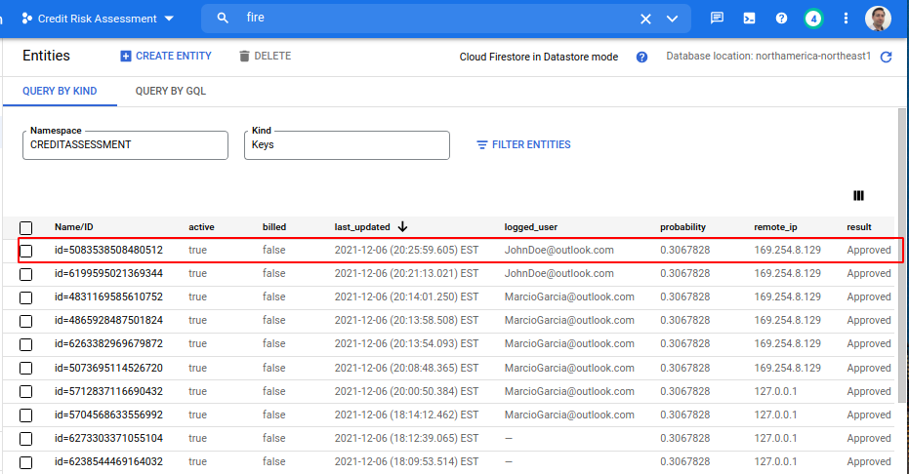
Validating with POSTMAN and FireStore
An authorized request can be made using Postman or curl.
All parameters are requested, along with the authorization key.
The result is a JSON record having
Result: [‘Approved’,’Declined’]
Default_probability in %

Slide 20
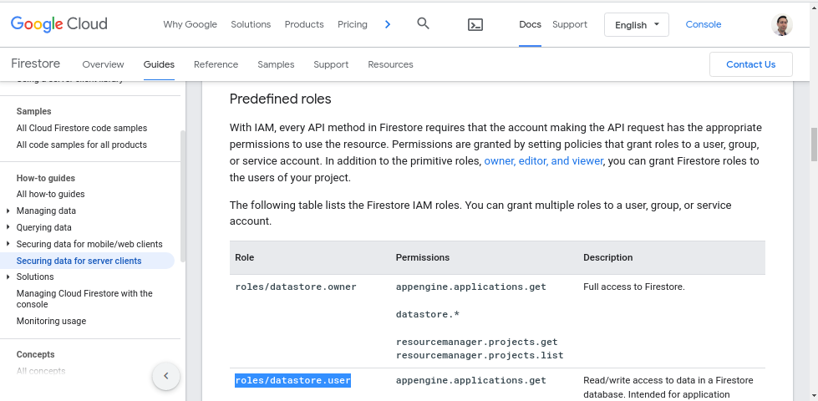
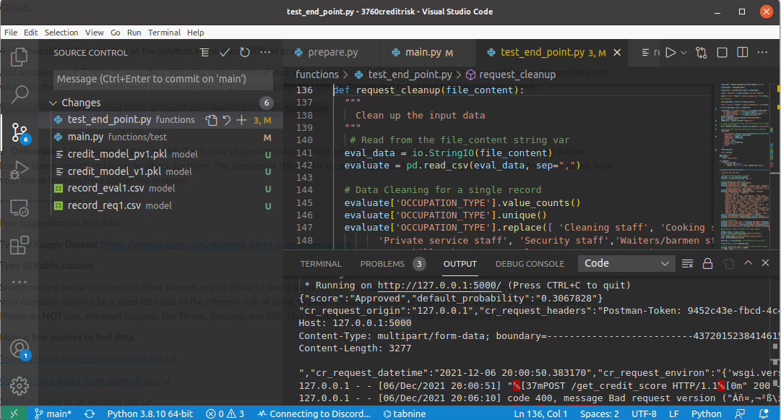
Top Challenges
Working with Cloud Functions specificities
Setting up IAM/Authorization roles without breaking everything
Choosing tools for a forecast of exponential growth

Slide 21
Thank you!
Ali Ghorbani
Humberto Ribeiro de Sousa
2021-12-07

